Slide 2
Can you help Ted read some sentences?
Read the sentence. Then, click on the paw prints to show the picture.
Hello!
I am Ted.
Which option would you like?
with sound buttons
without sound buttons

Slide 3
The tap is on.

Slide 4
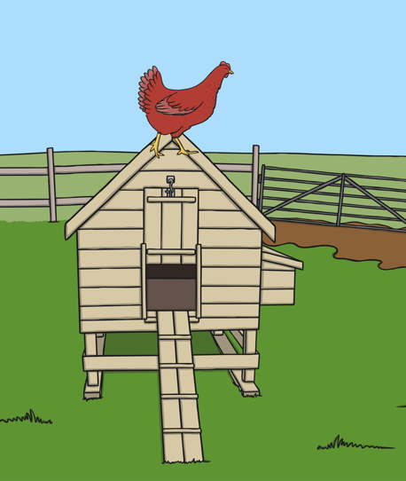
The red hen is on the hut.

Slide 5
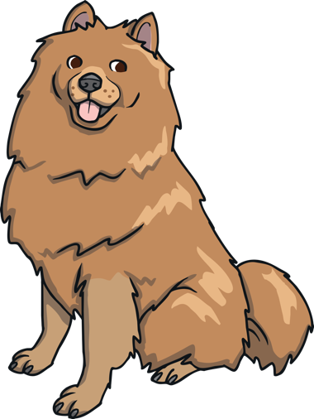
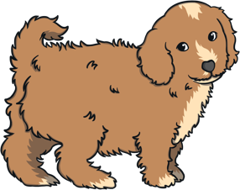
The dog has a pup.

Slide 6
The pen is red.

Slide 7
This time, read the sentence and click on the matching picture.

Slide 8
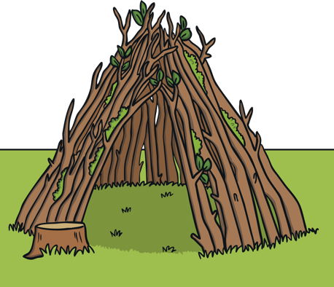
Ted is on top of the den.
Well done!

Slide 9
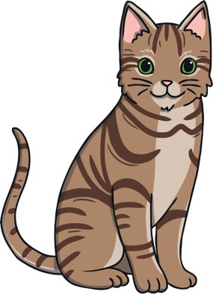
The cat has a hat.
Well done!

Slide 10
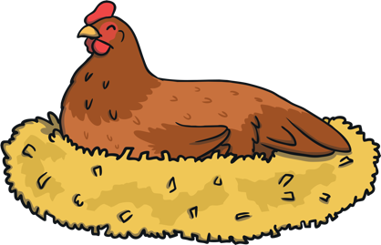
The hen had an egg.
Well done!

Slide 11
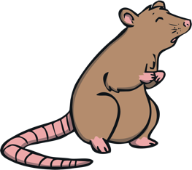
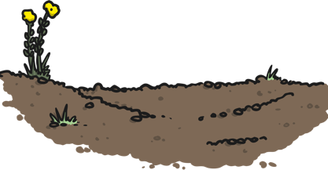
The pet rat is in the mud.
Well done!
finish

Slide 12
The tap is on.

Slide 13
The red hen is on the hut.

Slide 14
The dog has a pup.

Slide 15
The pen is red.

Slide 16
This time, read the sentence and click on the matching picture.

Slide 17
Ted is on top of the den.
Well done!

Slide 18
The cat has a hat.
Well done!

Slide 19
The hen had an egg.
Well done!

Slide 20
The pet rat is in the mud.
Well done!

Slide 21
Well done – super reading!

